Slide 1
HR ANALYSIS DASHBOARD
ATTRITION OF EMPLOYEES
BY:
Kaviya prabha

Slide 2

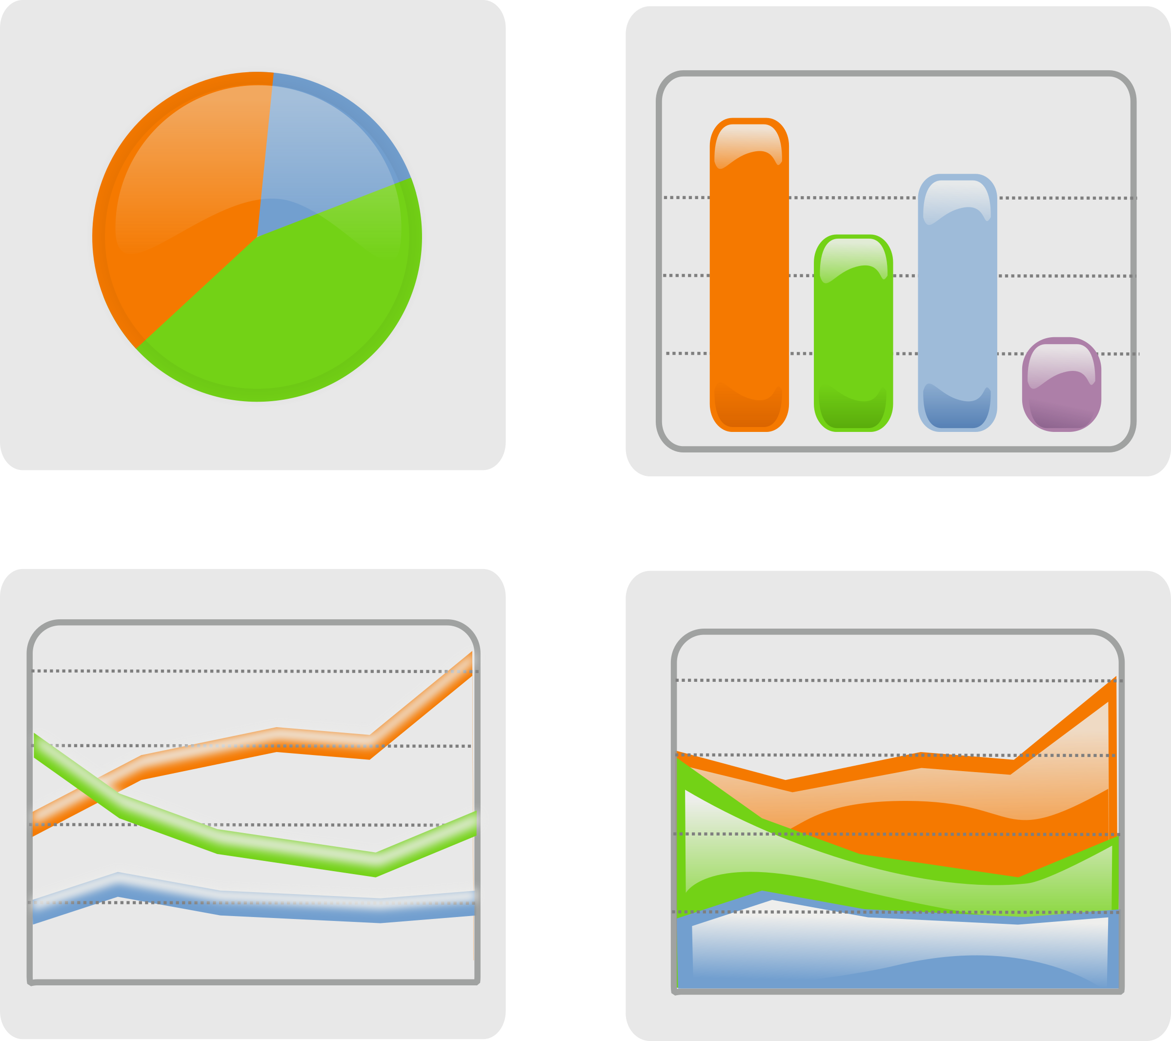
PROJECT OBJECTIVE :
The objective of this project is to perform an Exploratory Data Analysis (EDA) on the IBM HR Analytics Employee Attrition & Performance dataset using Tableau.
The goal is to gain insights into the factors influencing employee attrition and performance within the organization.
By examining various features and conducting statistical analysis, we aim to identify patterns, trends, and potential areas for improvement that can help the company better understand and manage employee attrition and performance.

Slide 3
PROBLEM STATEMENT:
KPI’s REQUIREMENT:
Employee Count:
To know about the total no of employees count in the dataset.
Attrition Count:
To find the total count of people who left the company.
Attrition Rate:
Calculate the percentage of attrition with sum of attrition count/ sum of employee count.
Active Employees:
To determine the active employees by deducting the attrition count from the total employee count.

Slide 4

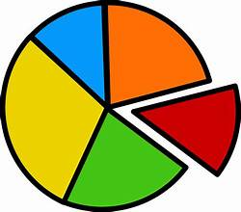

CHART REQUIREMENT:
Attrition By Gender:
Visualization: Lolipop Chart
Description : This chart illustrates the number of people who left the company, categorized by gender.
Department By Attrition:
Visualization : Pie Chart
Description : This chart will showcase the attrition of employees by department.
No of Employees By Age Group:
Visualization: Bar chart
Description: Display the distribution of employees by age group and highlight the group with the highest count.

Slide 5


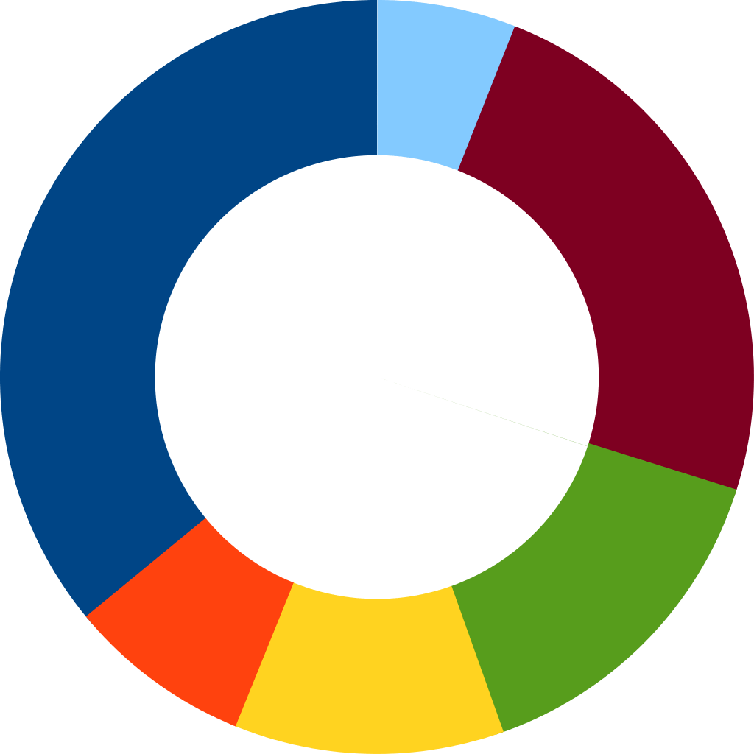
JOB SATISFACTION:
Visualization : Grid view
Description : Highlight the highest job satisfaction ratings.
Education field wise attrition:
Visualization : Bar chart
Description : It showcases the amount of attrition by educational field.
Attrition Rate by Gender for different age group:
Visualization : Donut Chart
Description : Attrition is differentiated by employees age and gender.

Slide 6
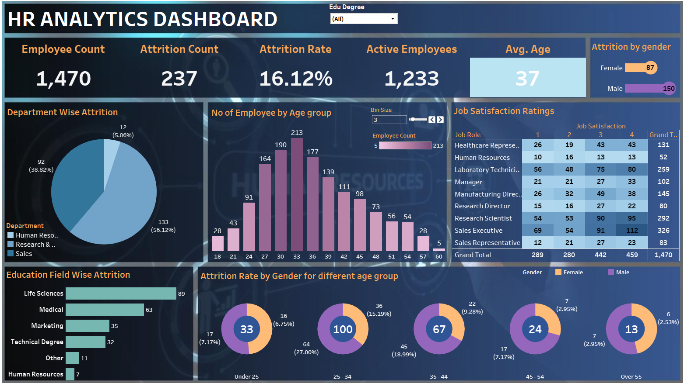
THE FINAL DASHBOARD:

Slide 7


